Slide 1

Utilizing Machine Learning For
The Identification of False News
GUIDE: Prof MEENA.V
BY
Kaloori Vivek - 125003406
Kompella Venkata Sai Sathvik - 125003395
Chekkada Meghashyam - 125003458
Guide
Meena.V
*
1

Slide 2
Base paper
H. L. Gururaj , H. Lakshmi, B. C. Soundarya , Francesco Flammini and V. Janhavi, “Machine Learning-Based Approach for Fake News Detection”, Department of Information Technology, Artificial Intelligence and Machine Learning.
Publishement : In 2022 By River Publisher
Journal Name : Journal of ICT Standardization
Indexing : Scopus
In this paper, the following algorithms has been used to find best accuracy for detecting false news.
Random forest
Logistic Regression
Passive Aggressive Classifier
Support Vector Machine
Page URL : https://ieeexplore.ieee.org/document/10255417
*
2

Slide 3
ABSTRACT
The study acknowledges the rapid adoption of social media and widespread internet availability, leading to an unprecedented spread of information. However, it highlights the challenge of false information proliferating online.
The research focuses on automatically categorizing text articles to differentiate between authentic and fraudulent information. Various textual characteristics are analyzed to achieve this, with a particular emphasis on evaluating the model's performance using different machine learning techniques.
The study explores several machine learning methods, including logistic regression, Naive Bayes, and neural networks (CNN and LSTM), to construct a classification model for predicting the dependability of news items. Feature extraction techniques like tokenization and TF-IDF are used to prepare the data.
Evaluation measures such as F1-score, precision, and recall are employed to assess the performance of the classification model. Feature significance analysis and ensemble approaches are utilized to improve prediction accuracy and interpretability.
The model incorporates strategies like oversampling to address class imbalance and ensures adaptability to changing patterns of disinformation through ongoing learning. The methodology aims to provide a comprehensive approach to combatting the spread of false information online.

Slide 4
Problem Statement
To Find best classifier algorithm for false news detection using Machine learning techniques
*
4

Slide 5
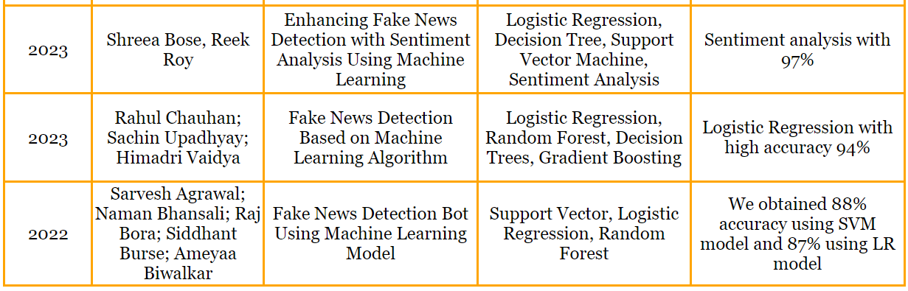
Literature survey
YEAR
AUTHOR
TITLE
MODEL
ACCURACY
*
5

Slide 6
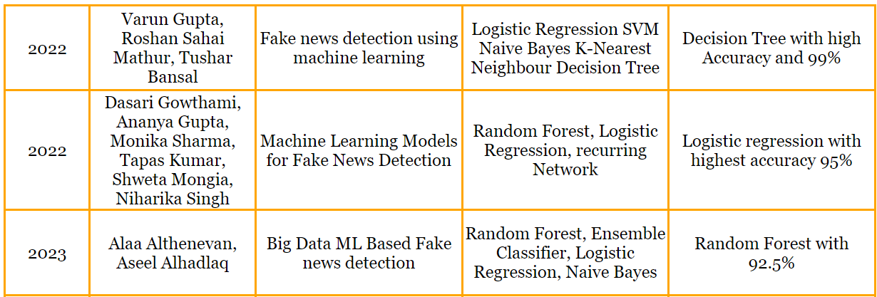
Literature survey
YEAR
AUTHOR
TITLE
MODEL
ACCURACY
*
6

Slide 7
Data Set
The False News dataset from the Kaggle machine learning repository
The True News dataset from the Kaggle machine learning repository.
The Dataset consists of 4 attributes and 5000 unique values.
There are 3 categorical attributes and 1 Date attribute.
Categorical Attributes were Title, Text, Subject that describes the property
of text under sections news, politics, others.
Date Attribute represents the date that news being spread on.
*
7

Slide 8
Modules
Module 1: Feature Selection
Data Collection
Data Preprocessing
Data Cleaning
Feature Generation
Module 2: Classification Algorithms
Random Forest
Logistic Regression
Support Vector Machine
Passive Aggressive Machine
Module 3: Implementation
Training the Model
Evaluation of Model
Web Application
*
8

Slide 9
Proposed techniques (Architecture)
Feature Selection
Data Collection
Data Preprocessing
Data Cleaning
Feature Generation
Classification
Random Forest
Logistic Regression
Support Vector Machine
Passive Aggressive Classifier
Dataset
Results
Implementation
Training the Model
Model Evaluation
Web Application
*
9

Slide 10
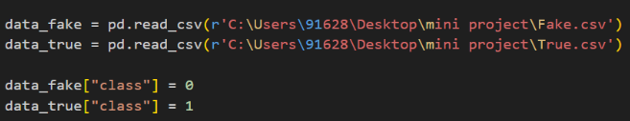
FEATURE SELECTION
DATA COLLECTION :
In base paper authors collected the dataset of news from different sources contains 6335 news articles simply classified as Fake or Real and later stored in a CSV file where attributes are Id, Title, Text, Class Label.
We collected a dataset from kaggle repository as a fake news dataset
consists of 5000 rows and true news dataset consists of 5000 rows
each of dataset consists of 4 attributes Id, Title, Text, Date

Slide 11
FEATURE SELECTION
DATA PREPROCESSING :
Data extracted from social media is typically unstructured and often comprises informal communication characterized by shortcuts, various slang terms, and poor grammar. To enhance performance and reliability, it's essential to preprocess this data before employing it in predictive modeling.
Preprocessing to be done as in steps reading data from datasets, adding class label attribute to the each of the dataset, concatenating it as single data, removing the unnecessary attributes, Checking for null values, Randomize the data, Resetting Index.

Slide 12
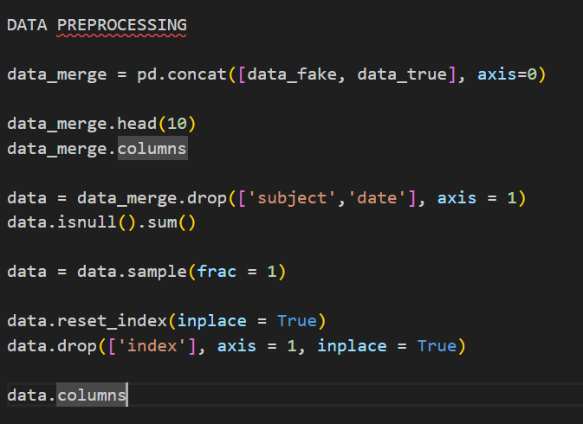
FEATURE SELECTION
DATA PREPROCESSING :

Slide 13
FEATURE SELECTION
DATA CLEANING :
Text and the data have to be cleaned to highlight the attributes which we want our machine learning system to work on accuracy.
Steps :
Punctuation Removal : we will eliminate every character which is special.
Tokenization : This process breaks down the context into specific units, such as sentences being divided into words, which helps to give structure to unstructured text.
Removing Stop Words : These common words frequently appear in any text but carry little information. Therefore, they are often removed.
Stemming : This process aids in reducing words to their base or stem form, often grouping related words together. It typically involves removing suffixes such as "er," "ible," "ness," etc., using a rule-based approach.

Slide 14
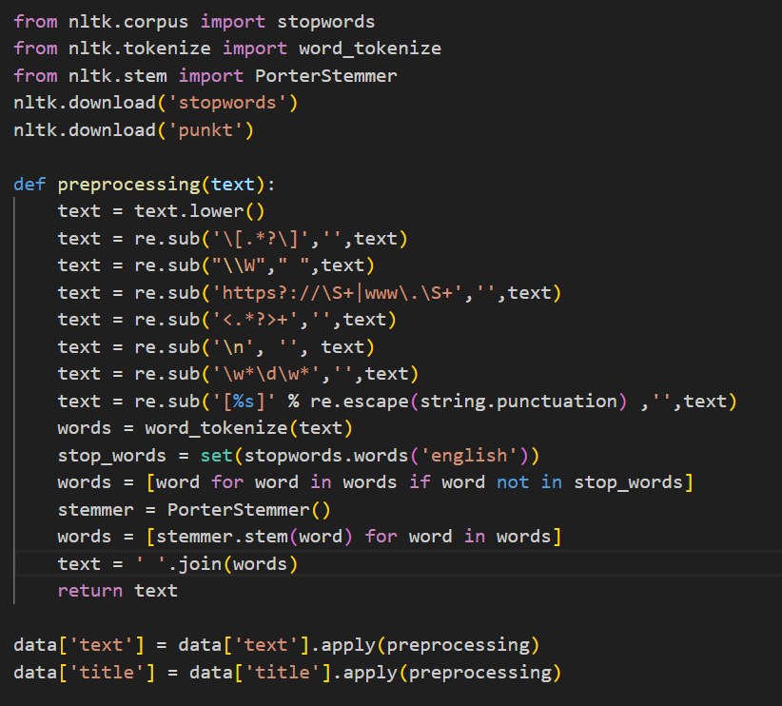
FEATURE SELECTION
DATA CLEANING :

Slide 15
FEATURE SELECTION
FEATURE GENERATION :
Countvectorizer : Countvectorizer is a method used to represent text data as a "bag of words." It counts the frequency of each word in a document and represents the presence of each word as 1 or 0 in a binary matrix.
TF-IDF (Term Frequency-Inverse Document Frequency) : TF-IDF is another method for text vectorization. It calculates the importance of a word in a document relative to its frequency in a corpus. TF measures the frequency of a term in a document, while IDF measures the rarity of a term in a corpus.
TF-IDF Calculation : TF-IDF is calculated by multiplying the TF of a term in a document by the IDF of the term across the corpus. This results in a matrix where rows represent documents, columns represent terms, and values represent the TF-IDF scores.

Slide 16
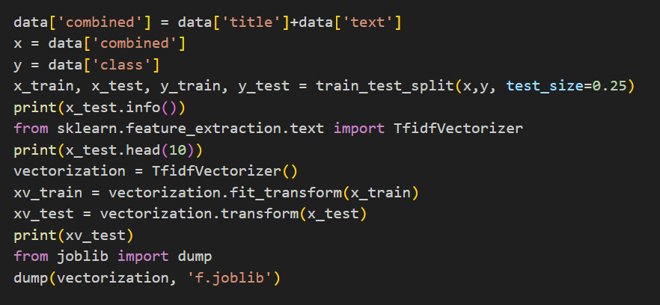
FEATURE SELECTION
FEATURE GENERATION :

Slide 17
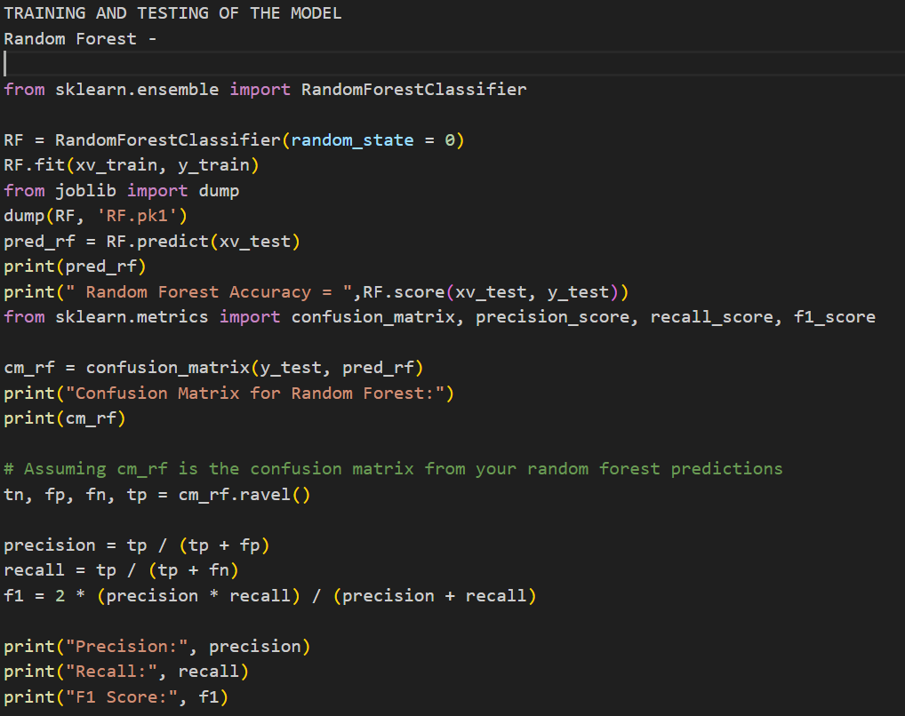
TRAINING AND TESTING
By Random Forest Algorithm -

Slide 18
TRAINING AND TESTING
Import Random Forest Classifier from Sk learn ensemble.
Create an instance of `Random Forest Classifier` with random state=0
and train it using xv train and y train data.
Save the trained classifier using job lib dump to a file named 'RF.pk1’.
Use the trained classifier to predict labels for xv test and calculate the
accuracy of the predictions using RF score(xv test, y test).
Compute the confusion matrix using confusion matrix for the
predictions made by the Random Forest classifier.
Extract true negatives (TN), false positives (FP), false negatives (FN), and
true positives (TP) from the confusion matrix.
Calculate precision, recall, and F1 score using these values.

Slide 19
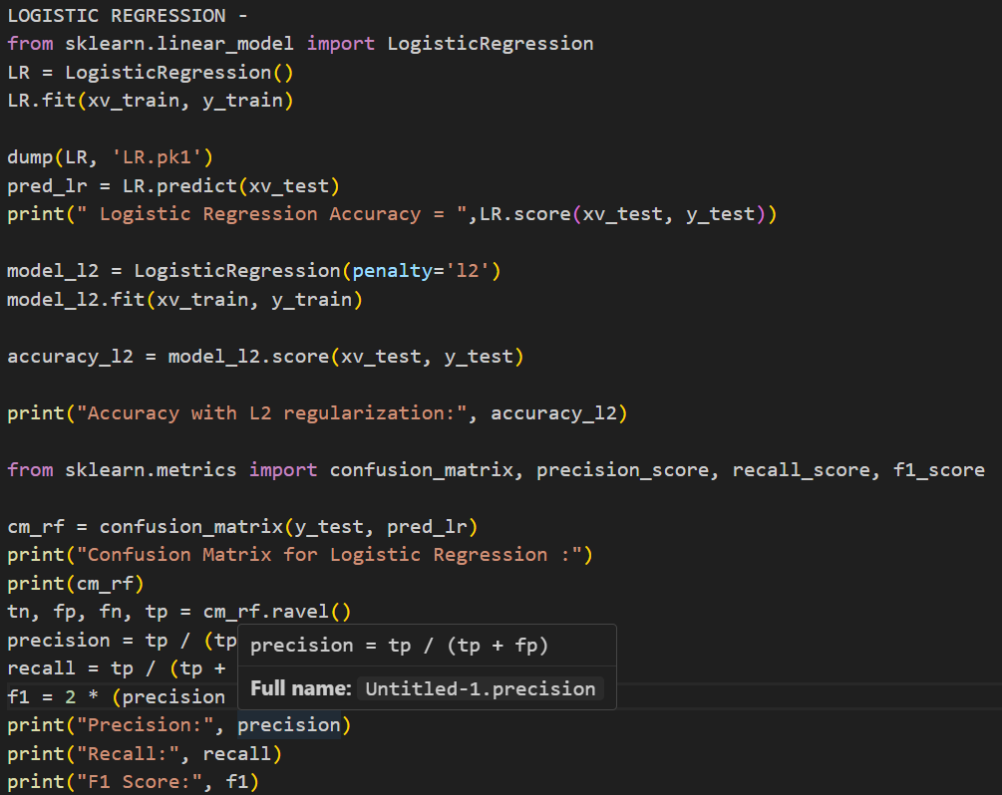
TRAINING AND TESTING
By Logistic Regression Algorithm -

Slide 20
TRAINING AND TESTING
- Import Logistic Regression from sk learn linear model.
- Create an instance of Logistic Regression and train it using xv train and
y train data.
- Save the trained classifier using job lib dump to a file named 'LR.pk1’.
- Use the trained classifier to predict labels for xv test and calculate the
accuracy of the predictions using LR score(xv test, y test).
- Compute the confusion matrix using confusion matrix for the
predictions made by the Logistic Regression model.
- Extract true negatives (TN), false positives (FP), false negatives (FN), and
true positives (TP) from the confusion matrix.
- Calculate precision, recall, and F1 score using these values.

Slide 21
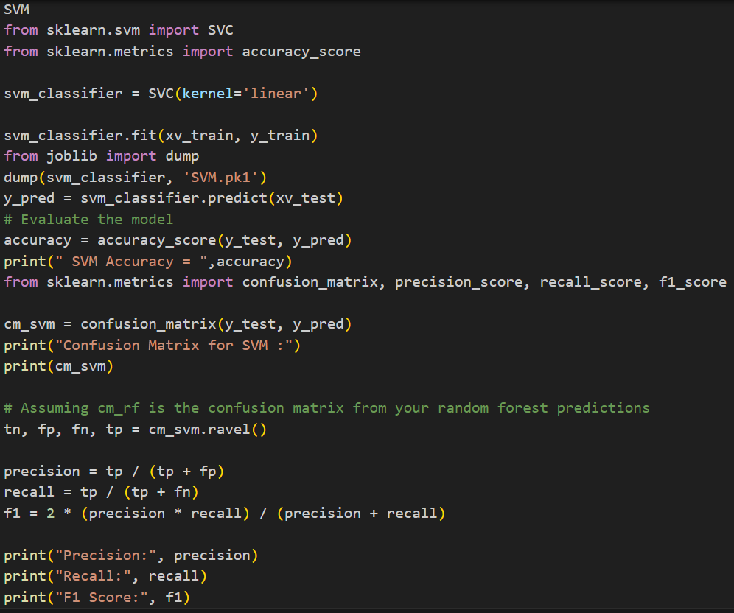
TRAINING AND TESTING
By Support Vector Machine Algorithm-

Slide 22
TRAINING AND TESTING
Import SVC from sklearn svm and accuracy score from
sk learn metrics.
Create an instance of SVC with kernel=‘linear’.
Train the classifier using xv train and y train data.
Save the trained classifier using `job lib dump` to a file named 'SVM.pk1'.
Use the trained classifier to predict labels for xv test and calculate the accuracy of the predictions using accuracy score.
Compute the confusion matrix using confusion matrix and extract true negatives (TN), false positives (FP), false negatives (FN), and true positives (TP) from it. Calculate precision, recall, and F1 score using these values.

Slide 23
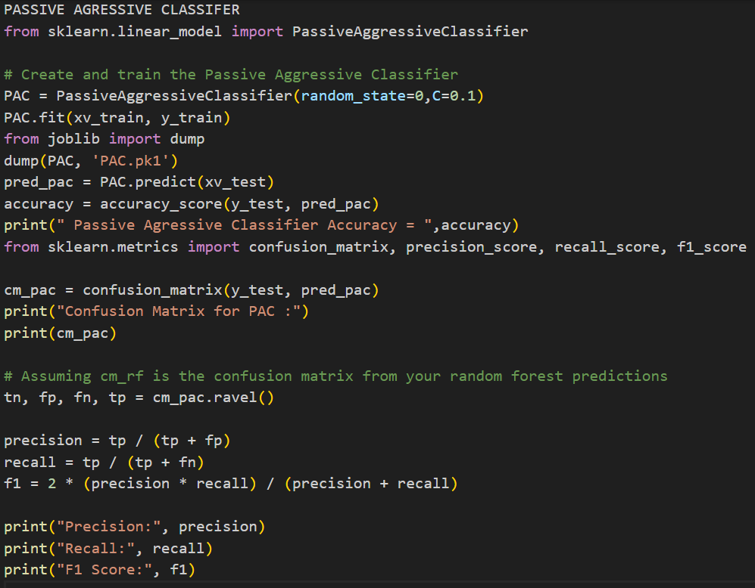
TRAINING AND TESTING
By Passive Aggressive Classifier Algorithm -

Slide 24
TRAINING AND TESTING
Import Passive Aggressive Classifier from sk learn linear model.
Create an instance of Passive Aggressive Classifier with random state=0 and C=0.1.
Train the classifier using xv train and y train data.
Save the trained classifier using job lib dump to a file named 'PAC.pk1'.
Use the trained classifier to predict labels for xv test and calculate the accuracy of the predictions using accuracy score.
Compute the confusion matrix using confusion matrix and extract true negatives (TN), false positives (FP), false negatives (FN), and true positives (TP) from it. Calculate precision, recall, and F1 score using these values.

Slide 25
MODEL EVALUATION
Metrices
Expected Results
Obtained Results

Slide 26
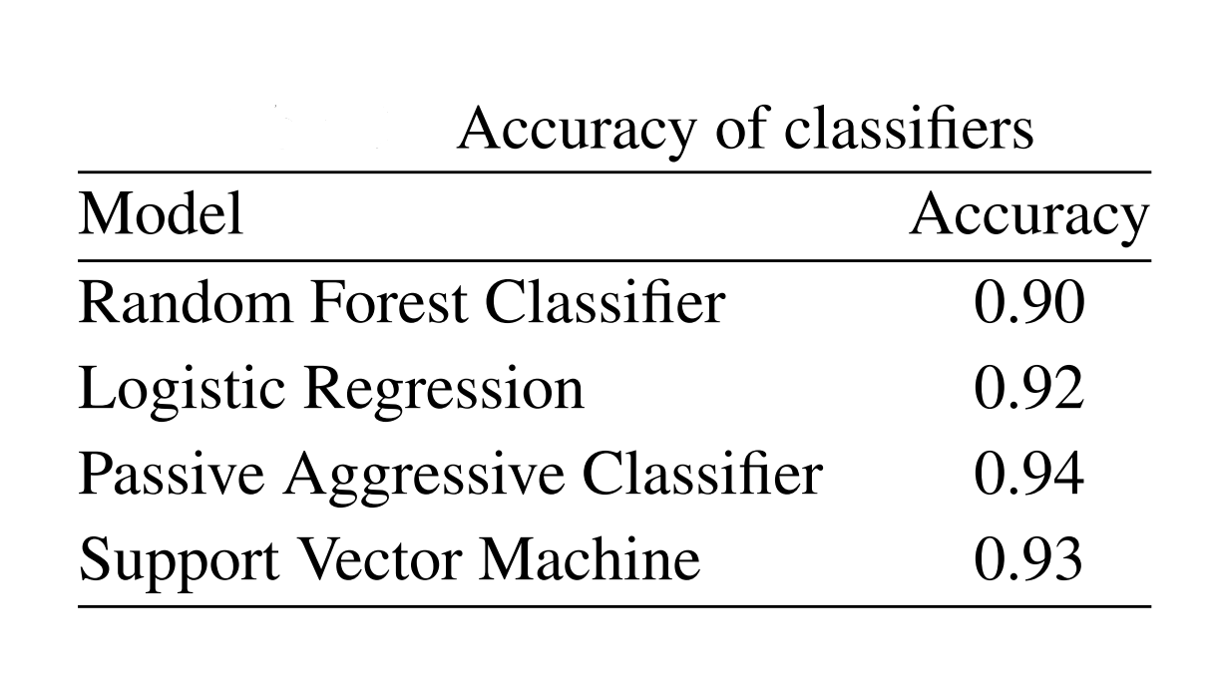
METRICS
Confusion matrix: A table that outlines the performance of a classifier on a bunch of test information for which the genuine values are known. It is used to visualize algorithm performance.
Precision = TP/(TP + FP)
Recall = TP /(TP + FN)
F1 Score = 2 *((precision*recall) / (precision + recall))
Accuracy = (TP + TN) / (TP + TN + FP + FN)
True Positive (TP)
True Negative (TN)
False Negative (FN)

Slide 27
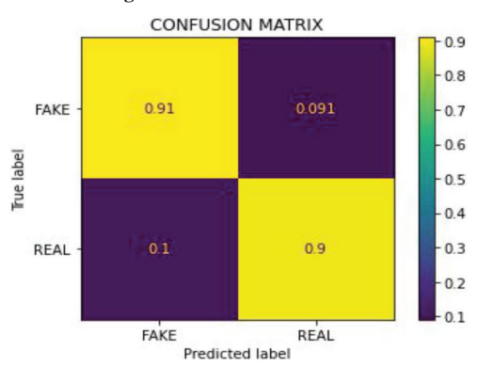
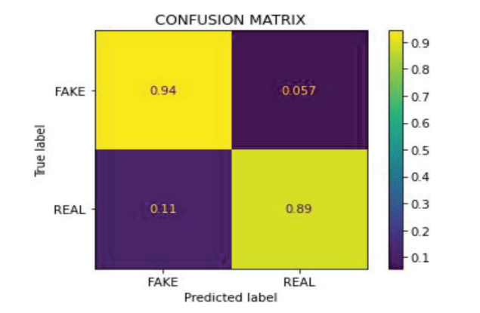
EXPECTED RESULTS
Random Forest -
Logistic Regression -

Slide 28
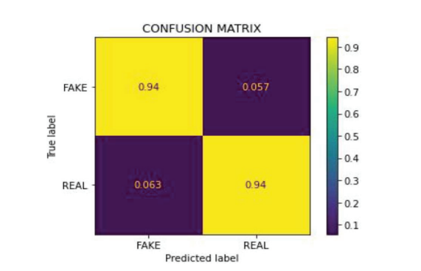
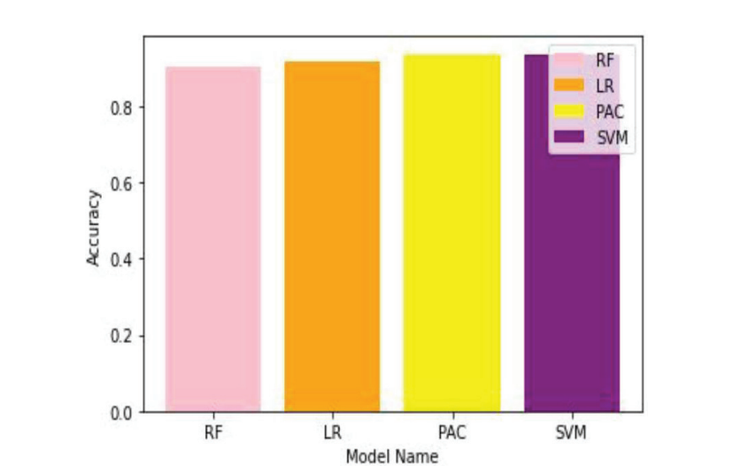
EXPECTED RESULTS
Passive Aggressive Classifier-
Comparison of Models -

Slide 29
EXPECTED RESULTS
Random Forest-
Precision : 0.9081
Recall : 0.9
F1 Score : 0.9040
Accuracy : 0.9
Logistic Regression -
Precision : 0.9398
Recall : 0.89
f1 Score : 0.9142
Accuracy : 0.92

Slide 30
EXPECTED RESULTS
Support Vector Machine -
Precision : 0.9321
Recall : 0.9239
F1 Score : 0.9254
Accuracy : 0.93
Passive Aggressive Classifier-
Precision : 0.9428
Recall : 0.9371
f1 Score : 0.9399
Accuracy : 0.94

Slide 31
OBTAINED RESULTS
Random Forest -
Logistic Regression -
0.9269
0.0949
0.9326
0..0939
FAKE
FAKE
0.0731
0.9050
0.0673
0.9060
REAL
REAL
FAKE
REAL
FAKE
REAL

Slide 32
OBTAINED RESULTS
Support Vector Machine -
Passive Aggressive Classifier -
0.9453
0.0877
0.9272
0.0822
FAKE
FAKE
0.0546
0.9122
0.0727
0.9177
REAL
REAL
FAKE
REAL
FAKE
REAL

Slide 33
OBTAINED RESULTS
Random Forest-
Precision : 0.9050
Recall : 0.9301
F1 Score : 0.9174
Accuracy : 0.9156
Logistic Regression -
Precision : 0.9083
Recall : 0.9357
f1 Score : 0.9218
Accuracy : 0.92

Slide 34
OBTAINED RESULTS
Support Vector Machine-
Precision : 0.9122
Recall : 0.9484
F1 Score : 0.9299
Accuracy : 0.928
Passive Aggressive Classifier -
Precision : 0.9177
Recall : 0.9293
f1 Score : 0.9235
Accuracy : 0.9224

Slide 35
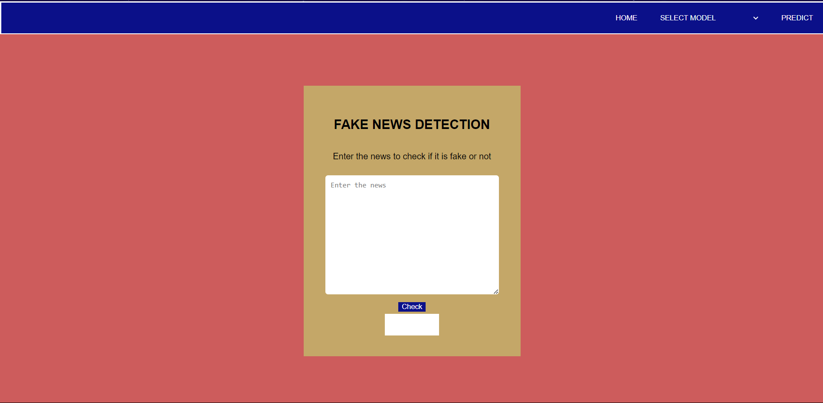
WEB APPLICATION
Interface to detect whether the news is Fake / Real

Slide 36
WEB APPLICATION
1. Blue Div (Upper Part of Page):
HTML Properties Used:
- `<div>` element with class or id for styling and JavaScript interaction.
Django Properties Used:
- Django templating for rendering the navigation options.
Features:
- Home: Navigates to the home page.
- Predict: Triggers the prediction process.
- Model: Selects the algorithm for prediction (Random Forest, Logistic Regression, SVM, PAC).

Slide 37
WEB APPLICATION
2. Yellow Div (Middle Part of Page):
HTML Properties Used:
- `<div>` element with class or id for styling.
- `<h1>` element for the heading.
- `<p>` element for the description.
- `<input>` element for text input.
- `<button>` element for the check button.
- Result field as a `<div>` element for displaying the prediction result.
Django Properties Used:
- Django templating for rendering dynamic content.

Slide 38
WEB APPLICATION
Features
- Head: "Fake News Detection"
- Description: "Enter the news"
- Text Field: Allows user to input news text.
- Check Button: Triggers the prediction process.
- Result Field: Displays the prediction result.
- For fake news: Red background.
- For true news: Green background.
- If user fails to input news or select a model, displays "Enter news, enter model" in yellow.
Overall, the web application uses Django for rendering dynamic content and HTML properties for structuring and styling the page. It provides a user-friendly interface for predicting whether a news article is fake or true.

Slide 39
Conclusion
The field of fake news detection research contains a vast dataset and many potential applications. We compare our model with the current dataset. Results indicates that the Maximum Accuracy of Support-Vector Machine algorithms is up to 92.8%. Thus, we developed our classification model for false news detectors using this classifier. The user can verify the news credibility by entering a phrase or keyword on the webpage.
We intend to develop our own dataset in the future that will be current and contain all the news pertinent to it. The database will be updated with the most recent data and real-time news. The next step is to train the model and analyze how its accuracy changes in light of the new data in order to enhance and refine it.
*
39

Slide 40
References
Iftikhar Ahmad et al. “Fake news detection using machine learning ensemble methods”. In: Complexity 2020 (2020).
Monther Aldwairi and Ali Alwahedi. “Detecting fake news in social media networks”. In: Procedia Computer Science 141 (2018), pp. 215–222.
Cody Buntain and Jennifer Golbeck. “Automatically identifying fake news in popular twitter threads”. In: 2017 IEEE International Conference on Smart Cloud (SmartCloud). IEEE. 2017, pp. 208–215.
Nadia K Conroy, Victoria L Rubin, and Yimin Chen. “Automatic deception detection: Methods for finding fake news”. In: Proceedings of the association for information science and technology 52.1 (2015), pp. 1–4.
Marco L Della Vedova et al. “Automatic online fake news detection combining content and social signals”. In: 2018 22nd Conference of Open Innovations Association (FRUCT). IEEE. 2018, pp. 272–279.
*
40

Slide 41
Thank you
*
41

